Slide 1
Kali Linux Installation
In this project we will Install “Kali Linux” In virtual box.
This will make your OS installation fast and correctly.

Slide 2
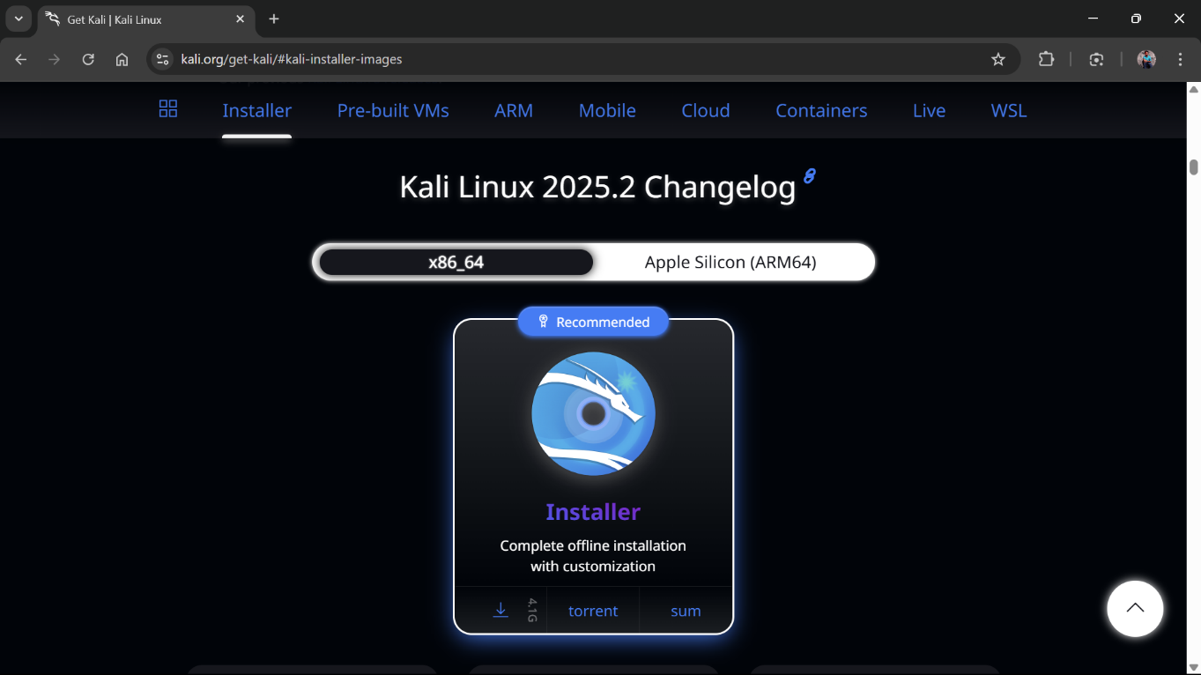
Download Requirements
Download “ISO” file for Kali Linux.
Here is Link To Download Kali Linux.
Select the ISO Compatible to your system.

Slide 3
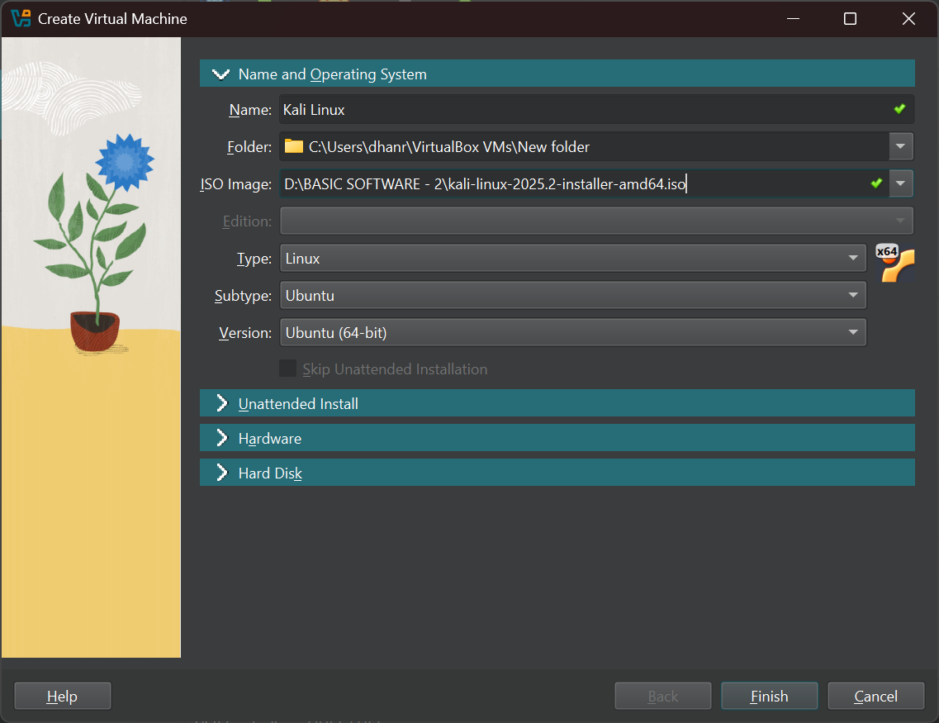
Create Virtual Machine
Click On ‘New Machine’ to Add New OS to virtual machine
Configure the ‘Name and Operating system’.
Add Name Eg. Kali Linux
Select the folder where you want to store the files created by Kali linux.
Select the Download ISO file.
Select type of OS Eg. Linux, Redhat, Debian X64.

Slide 4
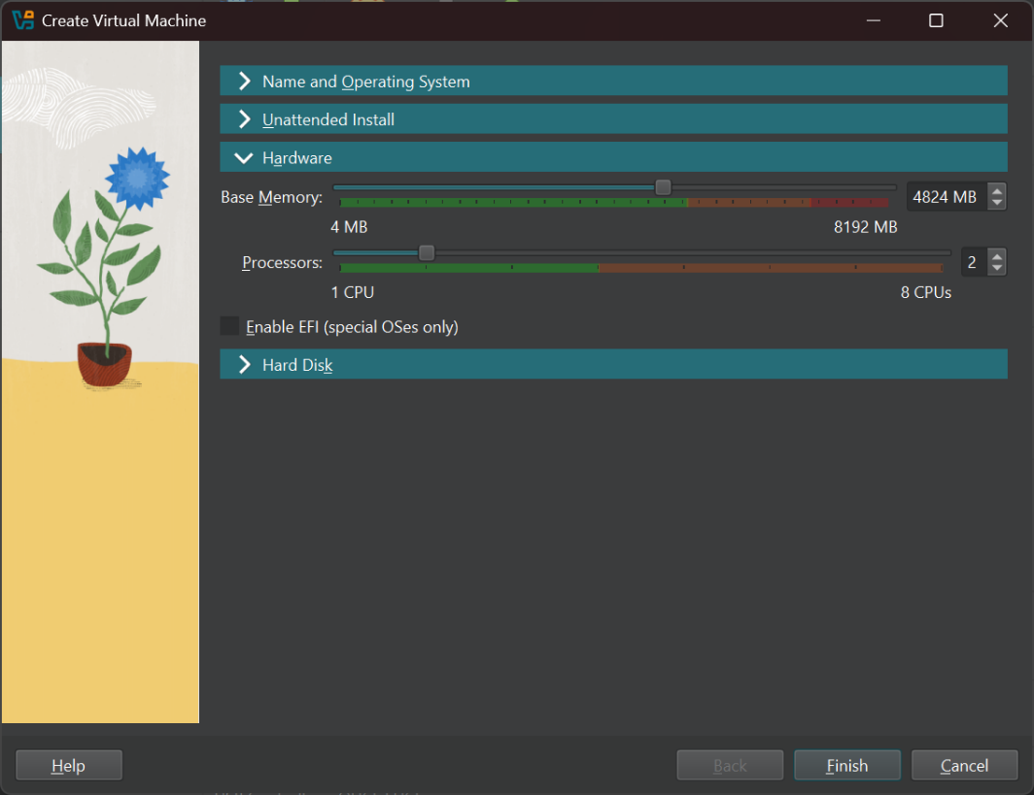
Create Virtual Machine
Hardware Configurations
Select the Base Memory (RAM) As per your Pc Compatibility.
As OS Needs Processors to run any type of Program.

Slide 5
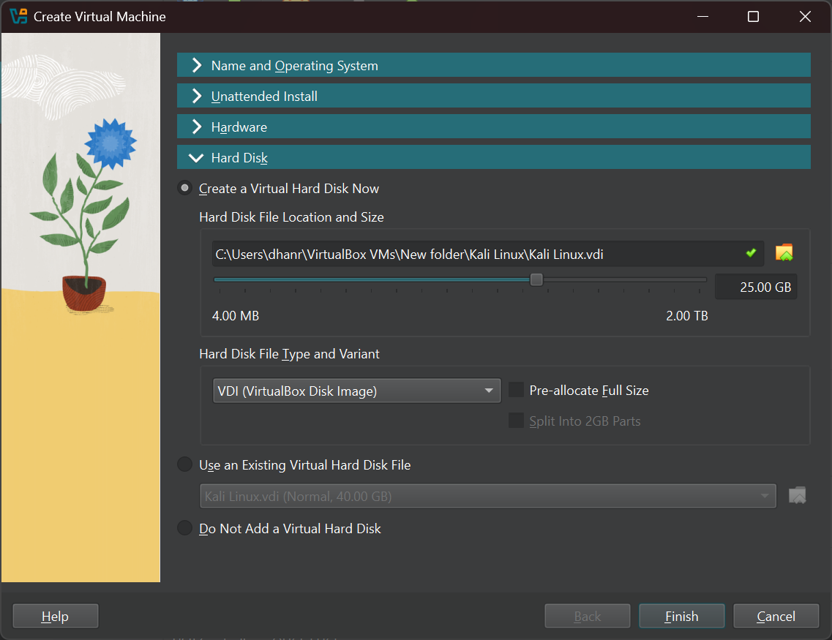
Create Virtual Machine
Hard Disk Configurations
Create a Virtual Hard disk where the Kali Linux will be get Installed.
The ideal Storage to Run Kali Linux Is form 20Gb to up to your PC storage.
Create a virtual storage of 20Gb.
Finish the configuration, the Kali Linux will BOOT.

Slide 6
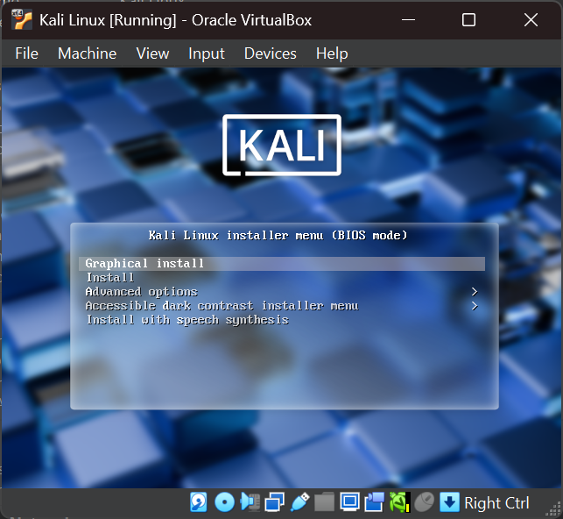
Kali Linux Configuration
Kali Linux (BIOS MODE)
Select the “Graphical install” Option to Install the Kali Linux.
If you select “install” option the it will just run the Kali Linux for one Time next time you have to install again.
Other options are not much to use now.

Slide 7
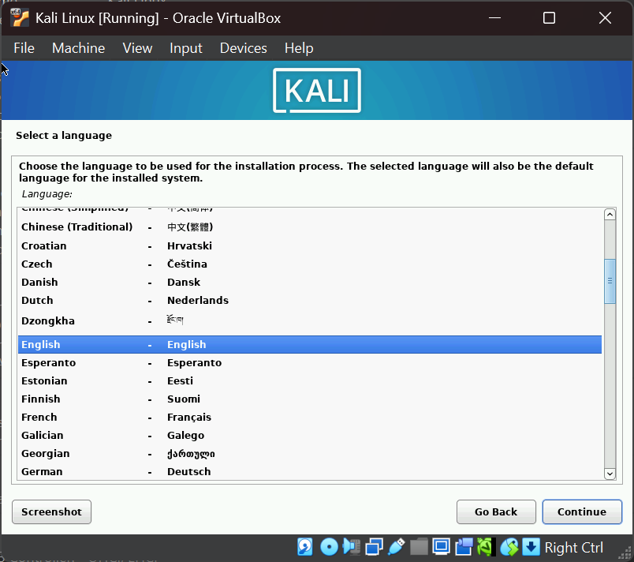
Kali Linux Configuration
Select a Language.
Choose the Language You want.
Mostly ‘English’ as it is Easy to Communicate.

Slide 8
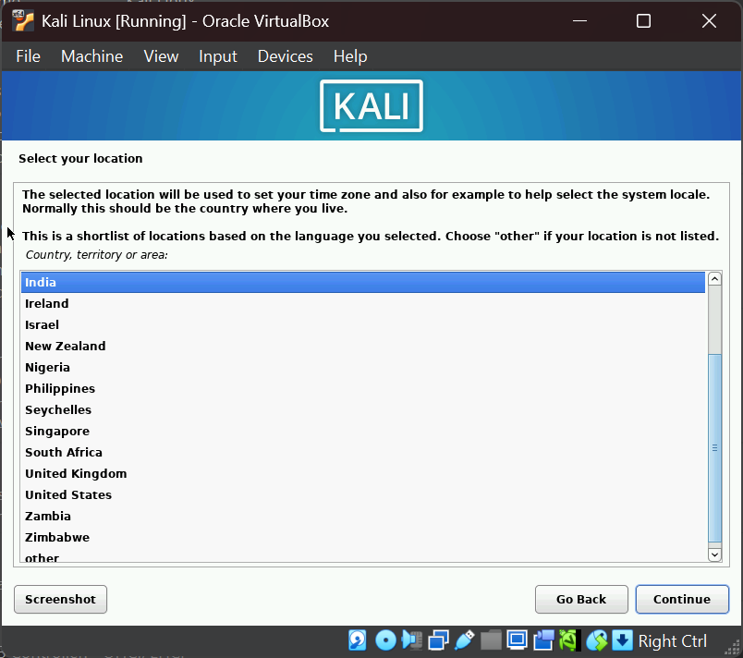
Kali Linux Configuration
Select Your Location
As OS need Region To configure Time.

Slide 9
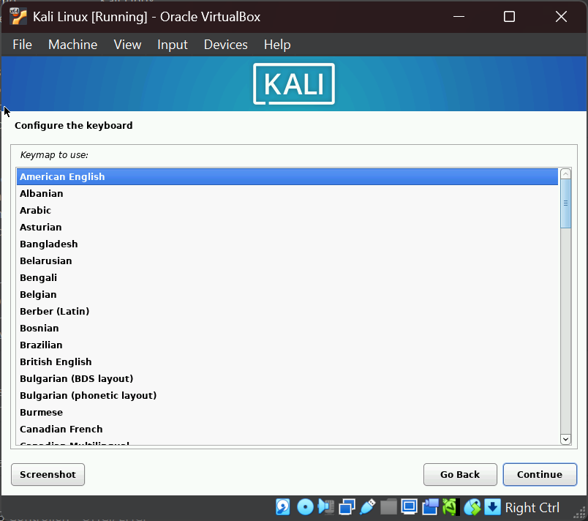
Kali Linux Configuration
Configure the Keyboard
Select the Keyboard of which language you want.
Mostly ‘American English’.

Slide 10
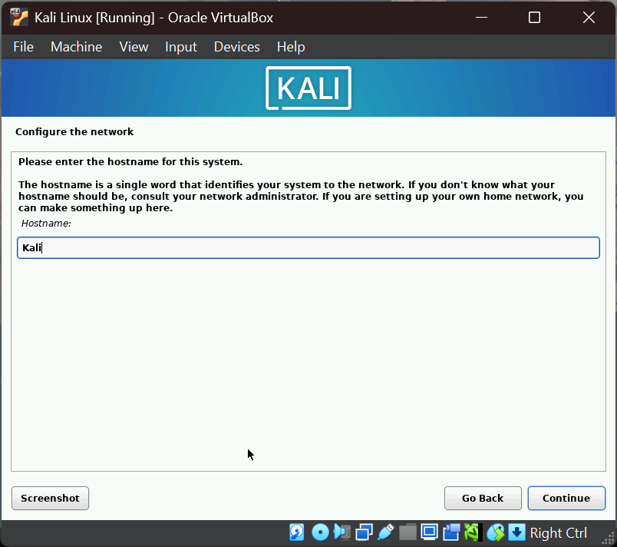
Kali Linux Configuration
Configure the network.
Enter the Hostname of the System.
Hostname: KALI

Slide 11
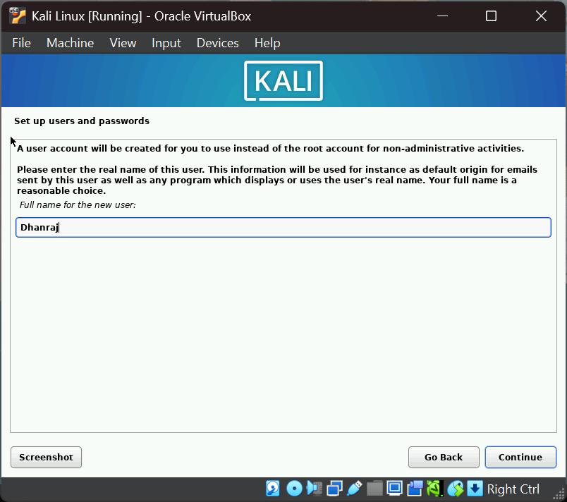
Kali Linux Configuration
Set up Users
Enter the full name of the New User.
New user: Dhanraj

Slide 12
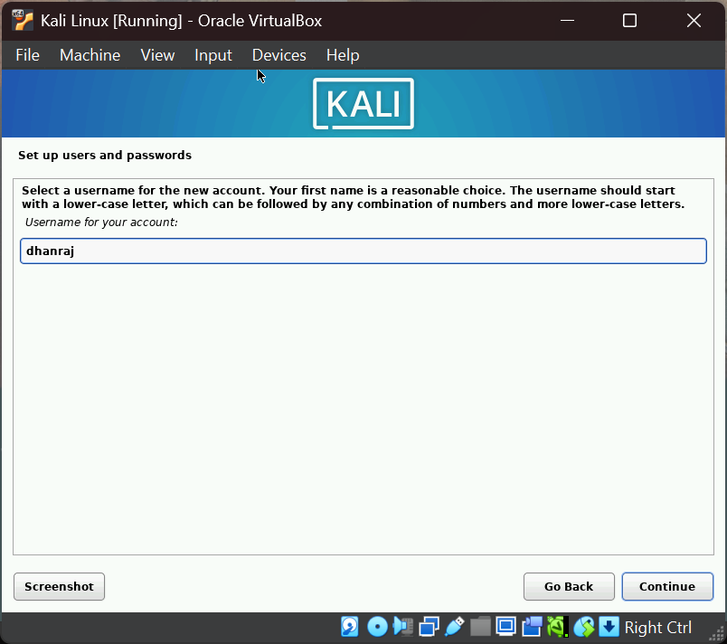
Kali Linux Configuration
Set up Users and passwords
Set the user name for your account.
Username: dhanraj

Slide 13
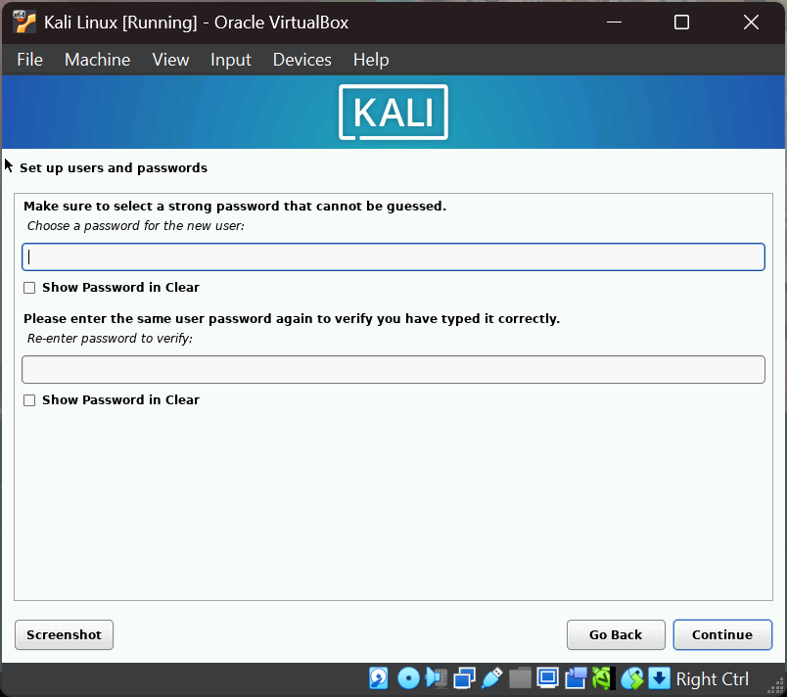
Kali Linux Configuration
Configure the Password.
Set a password for your kali linux system, which should be have to be strong.
And re-enter the password to make that password is correct.

Slide 14
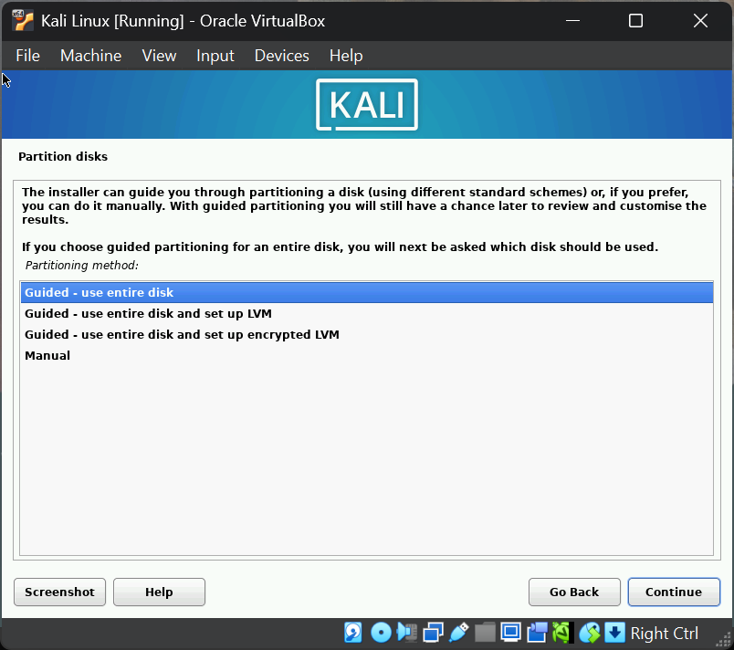
Kali Linux Configuration
Partition disk.
Select option 1 ‘Guided –use entire disk’
So it will configure all files in that one partitions.

Slide 15
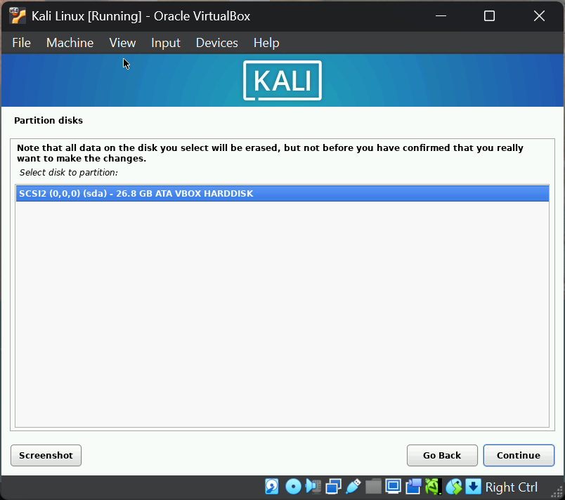
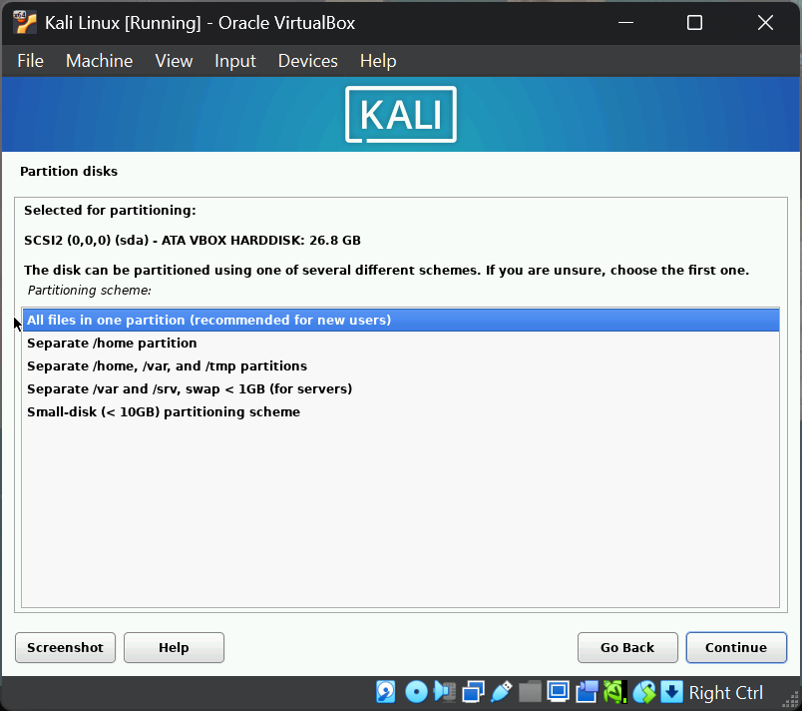
Kali Linux Configuration
Partition disk.
Select the disk we created previously.
Select All files in one Partition.
So we can save all files in one place.

Slide 16
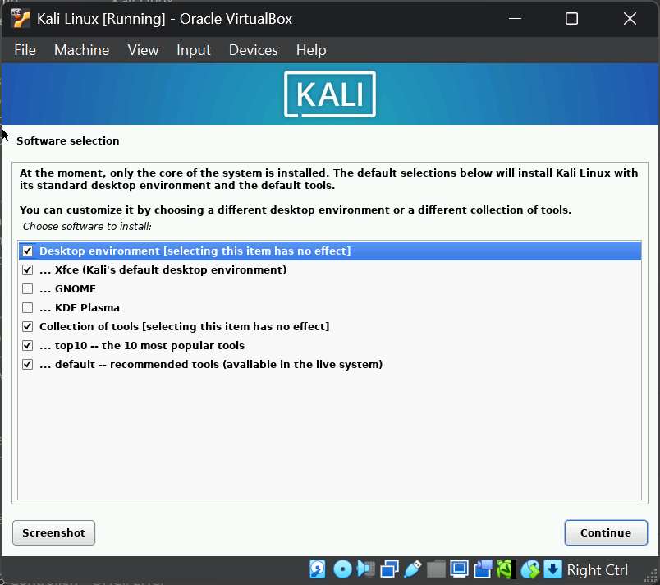
Kali Linux Configuration
Software Selection
Choose the software to install.
Mostly its Xfce (default)
It as pre loaded settings which makes user experience great.

Slide 17
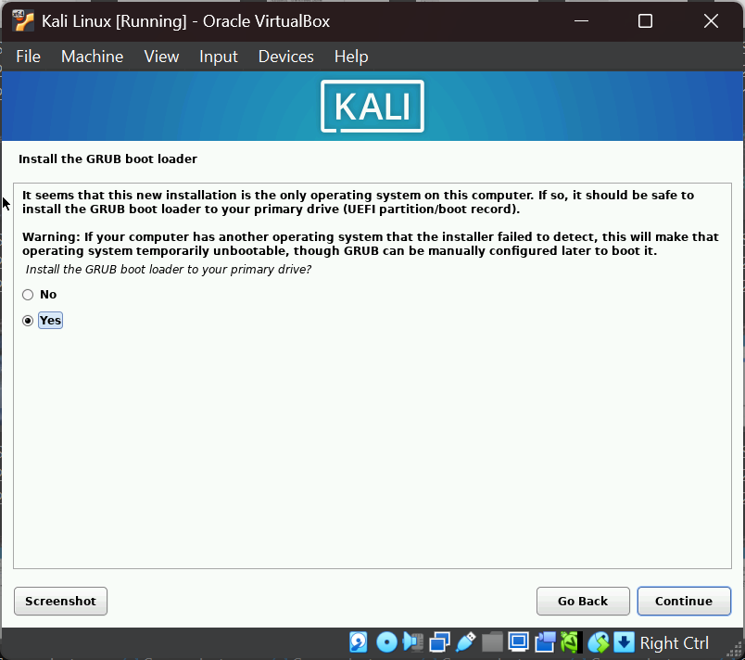
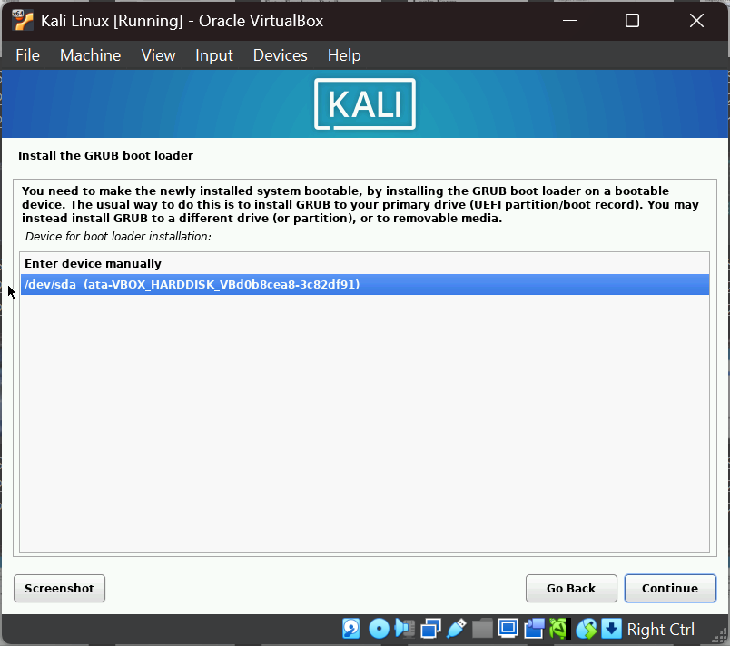
Kali Linux Configuration
Install the GRUB boot Loader.
Select ‘yes’ and continue.
Select the disk to where it should installed.

Slide 18
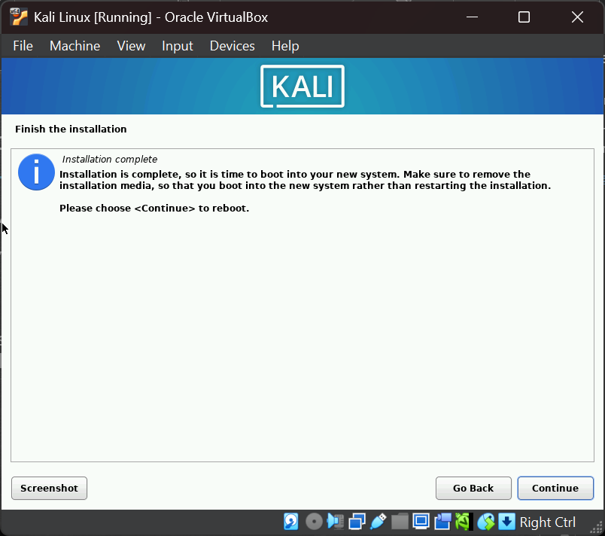
Kali Linux Configuration
Finish The Installation.
The installation is Complete.
Please choose <continue> to reboot.
And the OS will be Loaded in Virtual Machine.

Slide 19
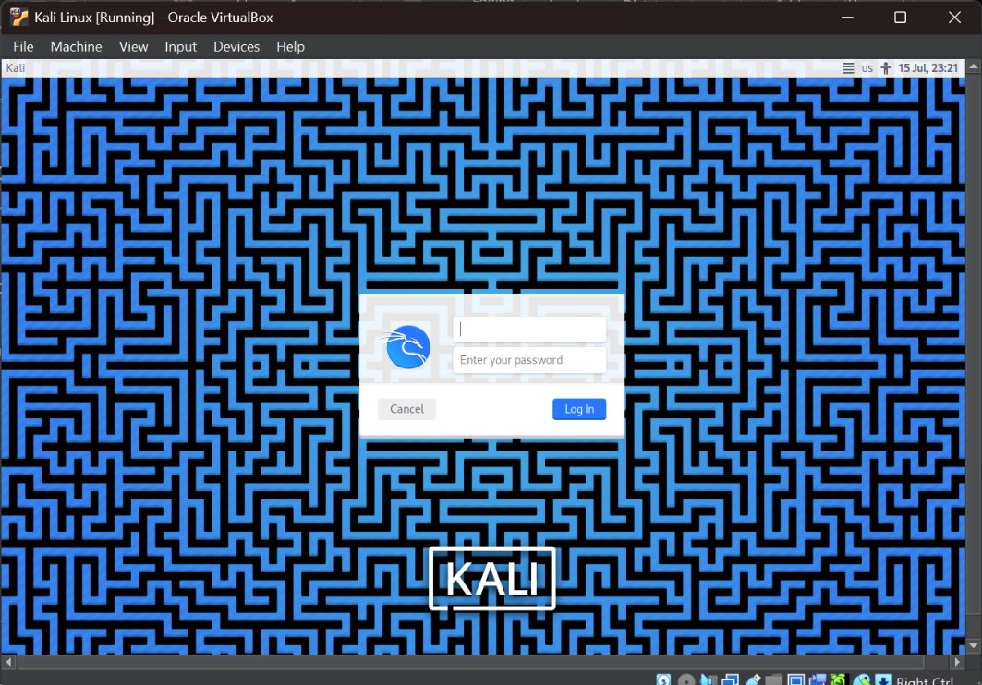
Kali Linux Loading
Finally the Kali Linux Installation Completed.
After Booting this login page will appear Fill the ‘username’ & ‘password’ to LOG IN

Slide 20
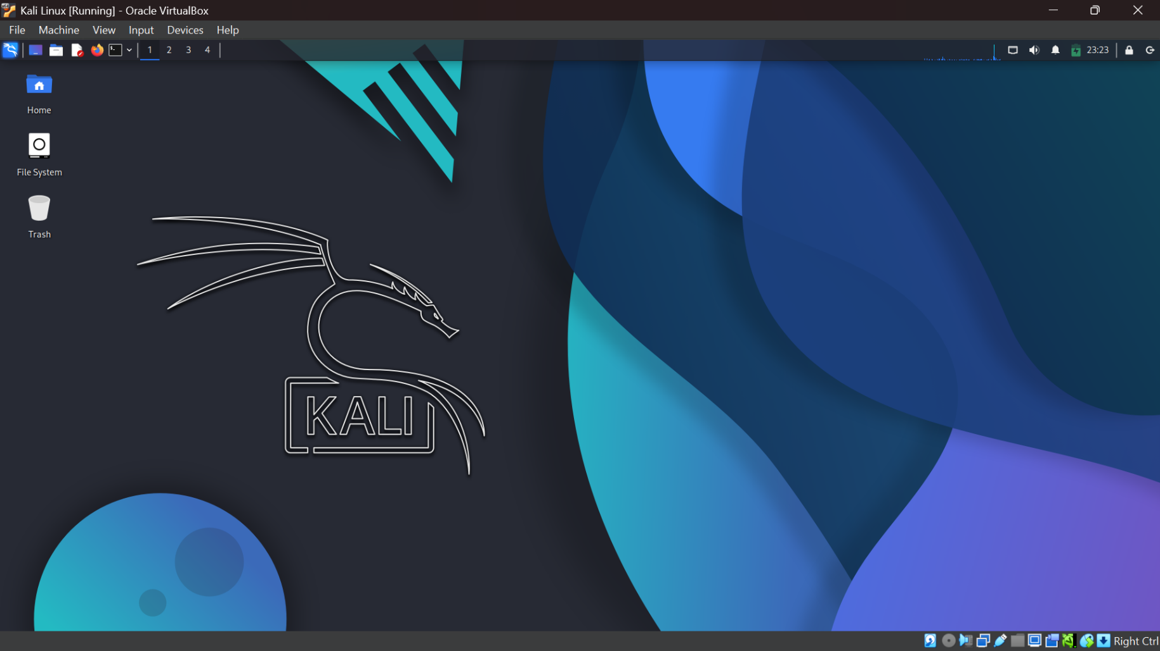
Kali Linux Desktop

